Slide 1
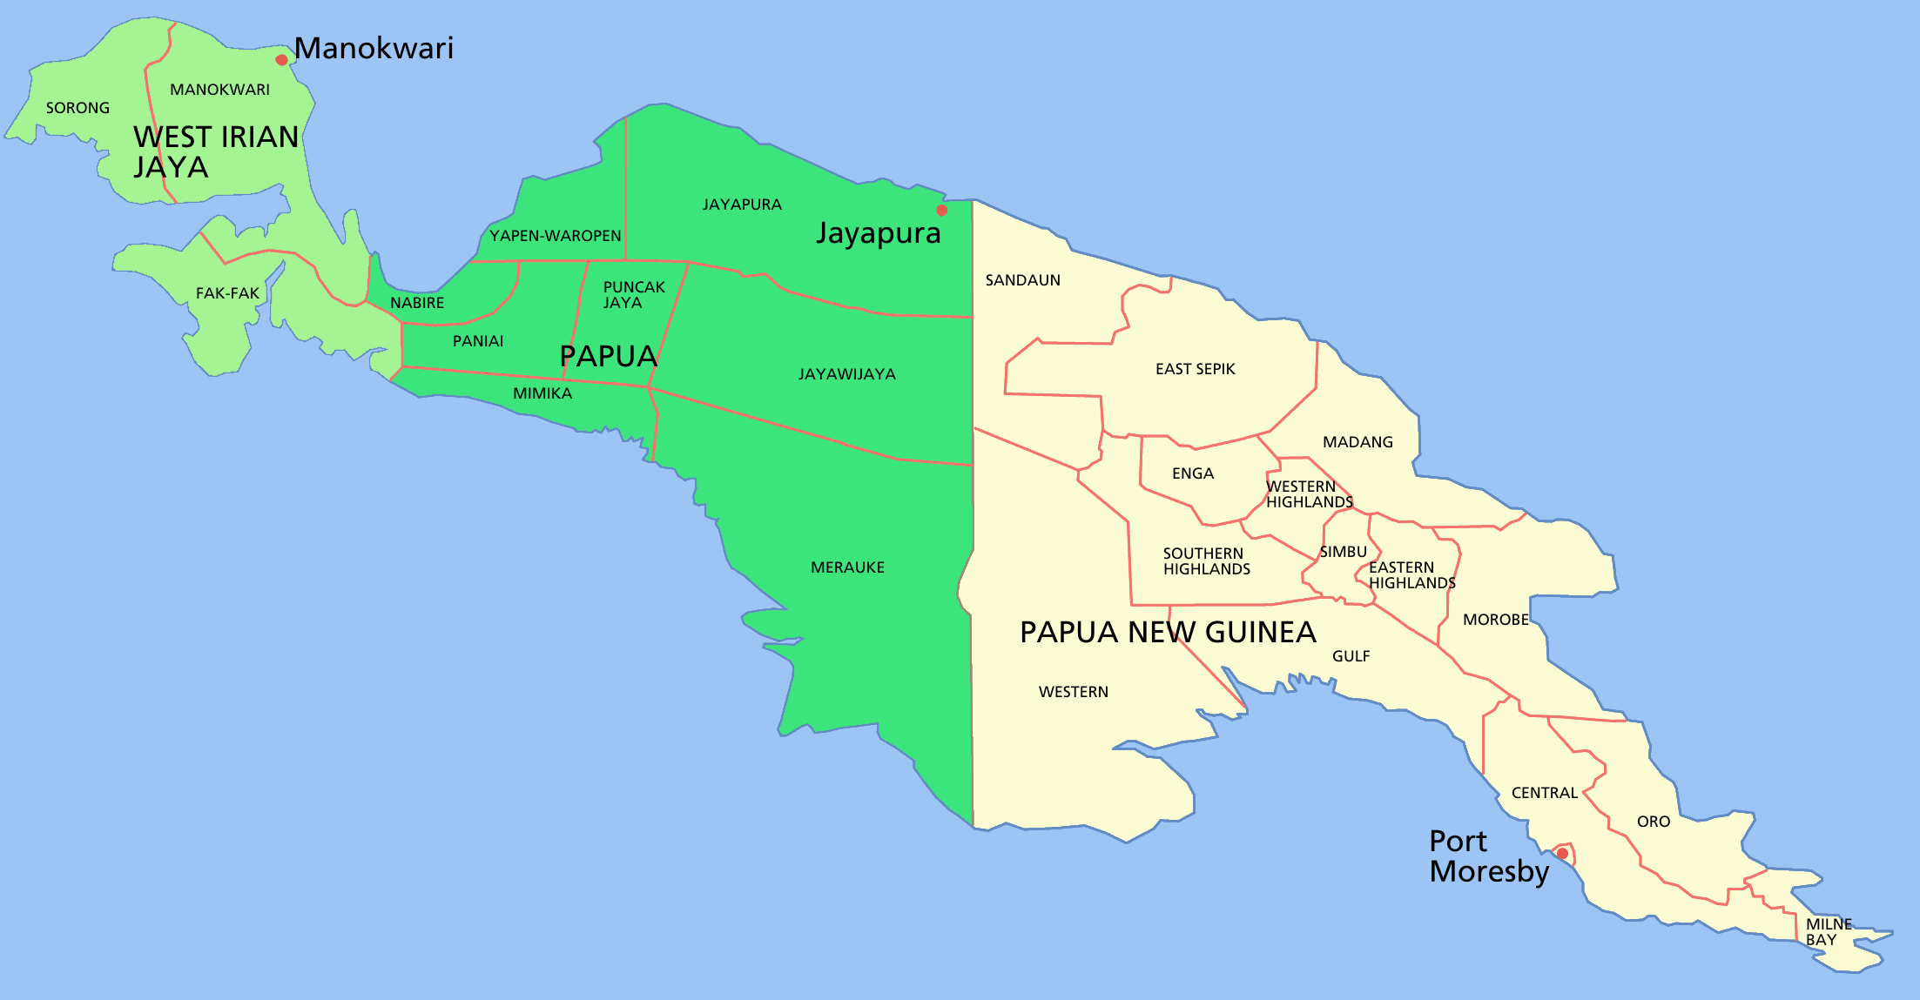
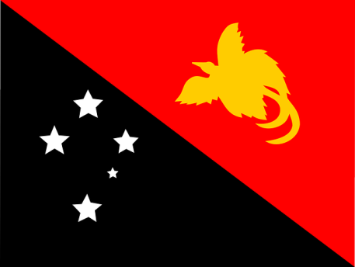
Year 10 Geography Comparative Case Study LAND
Country:
Papua New Guinea (PNG)

Slide 2
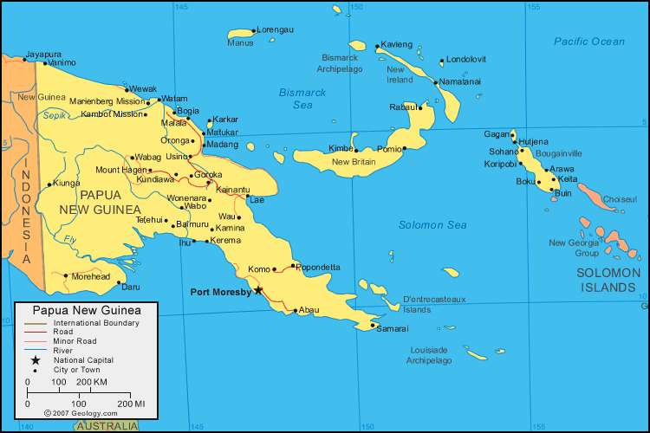
MAP – Papua New Guinea (PNG)

Slide 3
Background – Papua New Guinea
Less Developed Country or Developing Country.
Located/situated in the south western Pacific.
Coastline is approximately 5,150km
PNG has approximately 800 Indigenous language groups.
PNG is comprised of approximately 600 small islands.

Slide 4
Land degradation from deforestation and management in PNG
PLACE:
Situated/located approximately 160km north of Australia.
Situated approximately 4100km north east of Perth.
Port Moresby is the capital city. Port Moresby is situated at latitude 9° 26’ S and longitude 147° 10’ E.

Slide 5
Land degradation from deforestation and management in PNG
SPACE:
Forests originally covered approximately 66% of the land in Papua New Guinea.

Slide 6

Land degradation from deforestation and management in PNG
ENVIRONMENT:
Papua New Guinea’s forest contain 5% of the world’s biodiversity.

Slide 7
Land degradation from deforestation and management in PNG
SCALE:
Scale of Change over time (temporal distribution):
More than 50% of the vegetation (trees) could be lost to d__________________ by 2021.

Slide 8
Land degradation from deforestation and management in PNG
CAUSES OF DEFORESTATION:
Clearing the land for:
Timber
Mining
Population growth (e.g. building infrastructure and settlements)
Subsistence agriculture
Commercial agriculture – e.g. oil palm, cocoa and coffee.

Slide 9
Land degradation from deforestation and management in PNG
CONSEQUENCES OF DEFORESTATION:
Dislocation of indigenous people (Ecosystem Services - Spirituality)
Climate change
Loss of biodiversity – decline/reduction in the number, type and variety of species.
Loss of food
Soil degradation
Siltation of rivers

Slide 10
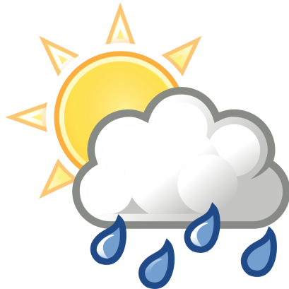
Land degradation from deforestation and management in PNG
INTERCONNECTION:
Forests help to regulate climate
Forests help to reduce soil erosion
Forests absorb CO2

Slide 11
Land degradation from deforestation and management in PNG
SUSTAINABILITY & MANAGEMENT
Sustainable Land Management Strategies are being developed, however, some of the strategies may be impacted on by economic growth, land disputes, institutional arrangements (including government) etc.
Strategies occurring at a variety of scales:
Global scale:
UN REDD+ focuses on increasing forest cover.
Works by paying countries and groups to protect forests.
*** Discuss what is meant by the UN REDD+ program
Link to ‘Sustainable Development Goals’

Slide 12
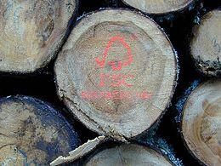
Land degradation from deforestation and management in PNG
SUSTAINABILITY & MANAGEMENT
National scale:
Forest Stewardship Council (FSC) developed a criteria to manage the land to meet the needs of present and future generations.
Criteria is based on social, economic and environmental (SEE) and cultural and spiritual needs.
Criteria links to SUSTAINABILITY.
Using a criteria allows for an ‘evaluation’ to take place.

Slide 13

Land degradation from deforestation and management in PNG
SUSTAINABILITY & MANAGEMENT
Local scale:
Eco-forestry industry implementation.
This means capping (limiting) the number of trees which can be harvested within Papua New Guinea.
Meaning of Eco-forestry:
selection or restoration forestry.

